Slide 1
Chapter Nine
Intertemporal Choice
跨时期选择

Slide 2
Structure
Present and future values
Intertemporal budget constraint
Preferences for intertemporal consumption
Intertemporal choice
Comparative statics

Slide 3
Intertemporal Choice
Persons often receive income in “lumps”; e.g. monthly salary.
How is a lump of income spread over the following month (saving now for consumption later)?
Or how is consumption financed by borrowing now against income to be received at the end of the month?

Slide 4
Present and Future Values
Begin with some simple financial arithmetic.
Take just two periods; 1 and 2.
Let r denote the interest rate per period.

Slide 5
Future Value
E.g., if r = 0.1 then $100 saved at the start of period 1 becomes $110 at the start of period 2.
The value next period of $1 saved now is the future value of that dollar.

Slide 6


Future Value
Given an interest rate r the future value one period from now of $1 is
Given an interest rate r the future value one period from now of $m is

Slide 7
Present Value （现值）
Suppose you can pay now to obtain $1 at the start of next period.
What is the most you should pay?
$1?
No. If you kept your $1 now and saved it then at the start of next period you would have $(1+r) > $1, so paying $1 now for $1 next period is a bad deal.

Slide 8
Present Value
Q: How much money would have to be saved now, in the present, to obtain $1 at the start of the next period?
A: $m saved now becomes $m(1+r) at the start of next period, so we want the value of m for which
m(1+r) = 1
That is, m = 1/(1+r),
the present-value of $1 obtained at the start of next period.

Slide 9
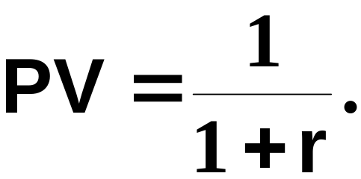
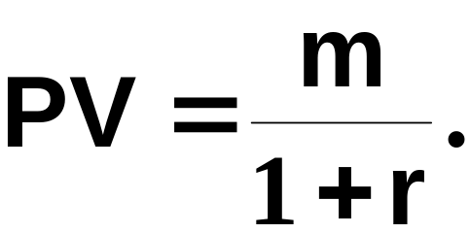
Present Value
The present value of $1 available at the start of the next period is
And the present value of $m available at the start of the next period is

Slide 10
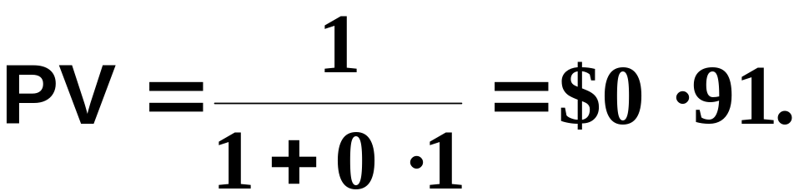
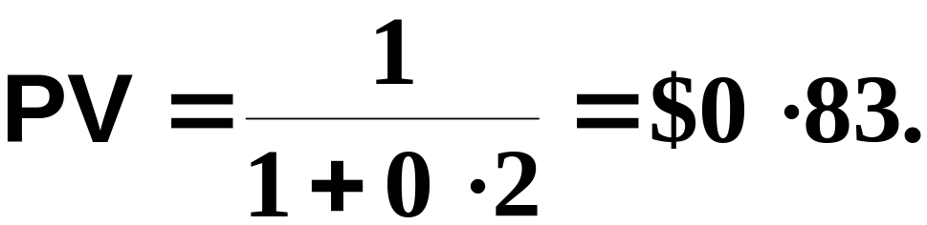
Present Value
E.g., if r = 0.1 then the most you should pay now for $1 available next period is
And if r = 0.2 then the most you should pay now for $1 available next period is

Slide 11
The Intertemporal Choice Problem
Let m₁ and m₂ be incomes received in periods 1 and 2.
Let c₁ and c₂ be consumptions in periods 1 and 2.
Let p₁ and p₂ be the prices of consumption in periods 1 and 2.

Slide 12
The Intertemporal Choice Problem
The intertemporal choice problem:
Given incomes m₁ and m₂, and given consumption prices p₁ and p₂, what is the most preferred intertemporal consumption bundle (c₁, c₂)?
For an answer we need to know:
  the intertemporal budget constraint
  intertemporal consumption preferences.

Slide 13
The Intertemporal Budget Constraint
To start, let’s ignore price effects by supposing that
p₁ = p₂ = $1.

Slide 14
The Intertemporal Budget Constraint
Suppose that the consumer chooses not to save or to borrow.
Q: What will be consumed in period 1?
A: c₁ = m₁.
Q: What will be consumed in period 2?
A: c₂ = m₂.

Slide 15
The Intertemporal Budget Constraint
c₂
m₂
0
0
m₁
c₁

Slide 16
The Intertemporal Budget Constraint
c₂
So (c₁, c₂) = (m₁, m₂) is the
consumption bundle if the
consumer chooses neither to
save nor to borrow.
m₂
0
0
m₁
c₁

Slide 17
The Intertemporal Budget Constraint
Now suppose that the consumer spends nothing on consumption in period 1; that is, c₁ = 0 and the consumer saves
s₁ = m₁.
The interest rate is r.
What now will be period 2’s consumption level?

Slide 18
The Intertemporal Budget Constraint
Period 2 income is m₂.
Savings plus interest from period 1 sum to (1 + r )m₁.
So total income available in period 2 is
m₂ + (1 + r )m₁.
So period 2 consumption expenditure is

Slide 19

The Intertemporal Budget Constraint
Period 2 income is m₂.
Savings plus interest from period 1 sum to (1 + r )m₁.
So total income available in period 2 is
m₂ + (1 + r )m₁.
So period 2 consumption expenditure is

Slide 20
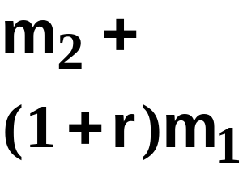
The Intertemporal Budget Constraint
c₂
the future-value of the income
endowment
m₂
0
0
m₁
c₁

Slide 21
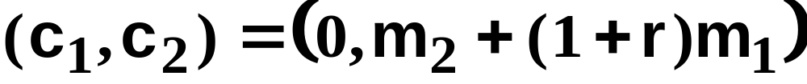
The Intertemporal Budget Constraint
c₂
is the consumption bundle when all
period 1 income is saved.
m₂
0
0
m₁
c₁

Slide 22
The Intertemporal Budget Constraint
Now suppose that the consumer spends everything possible on consumption in period 1, so c₂ = 0.
What is the most that the consumer can borrow in period 1 against her period 2 income of $m₂?
Let b₁ denote the amount borrowed in period 1.

Slide 23
The Intertemporal Budget Constraint
Only $m₂ will be available in period 2 to pay back $b₁ borrowed in period 1.
So b₁(1 + r ) = m₂.
That is, b₁ = m₂ / (1 + r ).
So the largest possible period 1 consumption level is

Slide 24
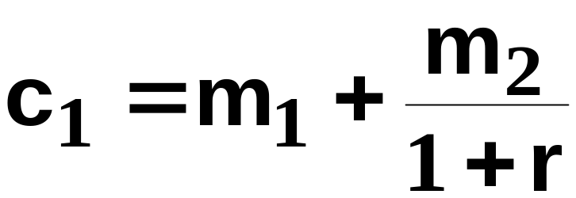
The Intertemporal Budget Constraint
Only $m₂ will be available in period 2 to pay back $b₁ borrowed in period 1.
So b₁(1 + r ) = m₂.
That is, b₁ = m₂ / (1 + r ).
So the largest possible period 1 consumption level is

Slide 25
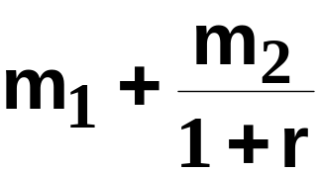
The Intertemporal Budget Constraint
c₂
is the consumption bundle when all
period 1 income is saved.
m₂
the present-value of
the income endowment
0
0
m₁
c₁

Slide 26
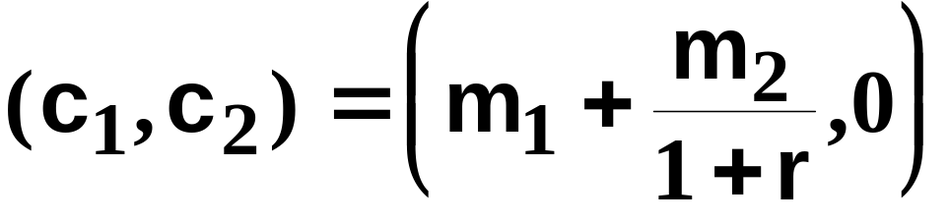
The Intertemporal Budget Constraint
c₂
is the consumption bundle when
period 1 saving is as large as possible.
m₂
is the consumption bundle
when period 1 borrowing
is as big as possible.
0
0
m₁
c₁

Slide 27
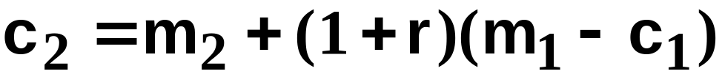
The Intertemporal Budget Constraint
Suppose that c₁ units are consumed in period 1. This costs $c₁ and leaves m₁- c₁ saved. Period 2 consumption will then be

Slide 28
The Intertemporal Budget Constraint
Suppose that c₁ units are consumed in period 1. This costs $c₁ and leaves m₁- c₁ saved. Period 2 consumption will then be
which is
⎪
⎪
⎩
⎧
⎨
⎩
⎧
⎨
slope
intercept

Slide 29
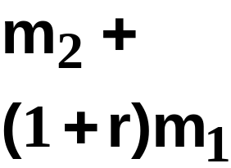
The Intertemporal Budget Constraint
c₂
slope = -(1+r)
m₂
0
0
m₁
c₁

Slide 30
The Intertemporal Budget Constraint
c₂
slope = -(1+r)
Saving
m₂
Borrowing
0
0
m₁
c₁

Slide 31
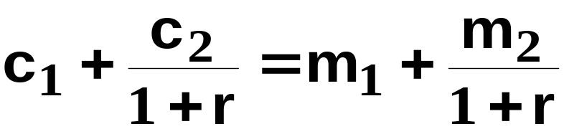
The Intertemporal Budget Constraint
is the “future-valued” form of the budget
constraint since all terms are in period 2
values. This is equivalent to
which is the “present-valued” form of the
constraint since all terms are in period 1
values.
As r rises, it is as if period 1 consumption is more expensive or period 2 consumption cheaper.

Slide 32
The Intertemporal Budget Constraint
If we allow for inflation or deflation, then prices of consumption goods may be different in two periods.
Use p₁ and p₂ to denote prices for consumption in periods 1 and 2.
How does this affect the budget constraint?

Slide 33
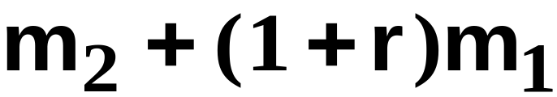
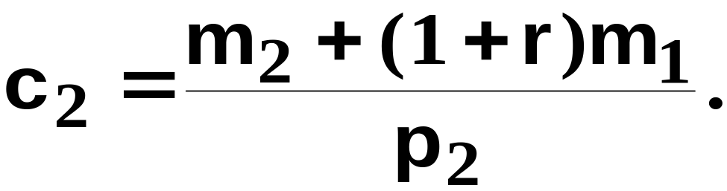
Intertemporal Choice
Given her endowment (m₁,m₂) and prices p₁, p₂ what intertemporal consumption bundle (c₁*,c₂*) will be chosen by the consumer?
Maximum possible expenditure in period 2 is
so maximum possible consumption in period 2 is

Slide 34
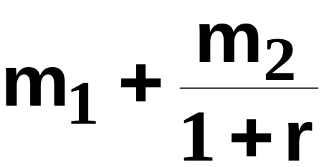
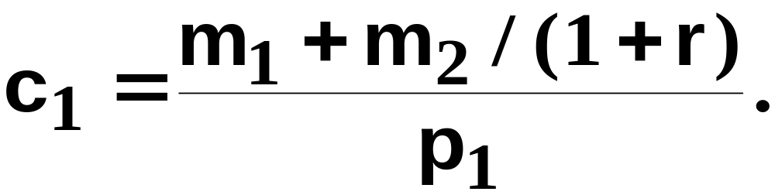
Intertemporal Choice
Similarly, maximum possible expenditure in period 1 is
so maximum possible consumption in period 1 is

Slide 35
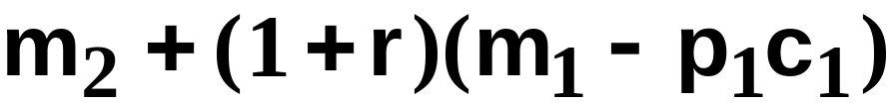
Intertemporal Choice
Finally, if c₁ units are consumed in period 1 then the consumer spends p₁c₁ in period 1, leaving m₁ - p₁c₁ saved for period 1. Available income in period 2 will then be
so

Slide 36

Intertemporal Choice
rearranged is
This is the “future-valued” form of the
budget constraint since all terms are
expressed in period 2 values. Equivalent
to it is the “present-valued” form
where all terms are expressed in period 1
values.

Slide 37
The Intertemporal Budget Constraint
c₂
m₂/p₂
0
0
m₁/p₁
c₁

Slide 38
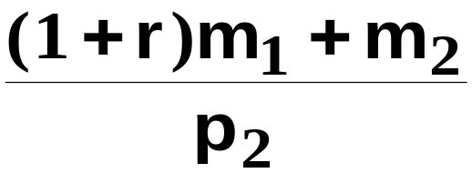
The Intertemporal Budget Constraint
c₂
m₂/p₂
0
0
m₁/p₁
c₁

Slide 39
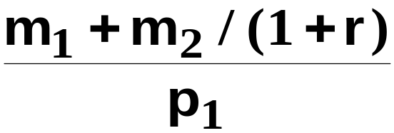
The Intertemporal Budget Constraint
c₂
m₂/p₂
0
0
m₁/p₁
c₁

Slide 40
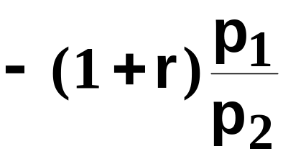
The Intertemporal Budget Constraint
c₂
Slope =
m₂/p₂
0
0
m₁/p₁
c₁

Slide 41
The Intertemporal Budget Constraint
c₂
Slope =
Saving
m₂/p₂
Borrowing
0
0
m₁/p₁
c₁

Slide 42
Intertemporal Preferences
Extreme cases
  Perfect substitute
  Perfect complement
Intermediate case of well-behaved preferences

Slide 43
Intertemporal Preferences
c₂
c₁

Slide 44
Intertemporal Choice
c₂
c₂
m₂/p₂
m₂/p₂
0
c₁
m₁/p₁
c₁
m₁/p₁
0
The consumer saves.
The consumer borrows.

Slide 45
Comparative Statics
Interest rate rises or falls
Price inflation

Slide 46
Comparative Statics
The slope of the budget constraint is
The constraint becomes flatter if the interest rate r falls.
The constraint becomes steeper if the interest rate r rises.

Slide 47
Comparative Statics
c₂
slope =
m₂/p₂
m₁/p₁
c₁

Slide 48
Comparative Statics
c₂
slope =
m₂/p₂
0
0
m₁/p₁
c₁
The consumer saves.

Slide 49
Comparative Statics
c₂
slope =
A decrease in the interest rate
“flattens” the
budget constraint.
m₂/p₂
0
0
m₁/p₁
c₁
The consumer saves.

Slide 50
Comparative Statics
c₂
slope =
If the consumer choose to
remain a lender then her
welfare is reduced by a lower
interest rate. Sign
on saving is
ambiguous.
m₂/p₂
0
0
m₁/p₁
c₁
The consumer initially saves.

Slide 51
Comparative Statics
c₂
slope =
m₂/p₂
0
0
m₁/p₁
c₁
The consumer borrows.

Slide 52
Comparative Statics
c₂
slope =
A fall in the interest rate
“flattens” the
budget constraint.
m₂/p₂
0
0
m₁/p₁
c₁
The consumer borrows.

Slide 53
Comparative Statics
c₂
slope =
The consumer will remain a
borrower. Welfare is
increased by a lower
interest rate. Sign on
borrowing unclear .
m₂/p₂
0
0
m₁/p₁
c₁
The consumer borrows.

Slide 54
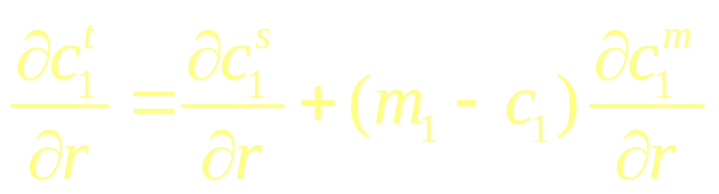
Slutsky Equation and Intertemporal Choice
(?) (-) (?) (+)
If borrower, (m-c)<0, total effect is negative.
If lender, (m-c)>0, total effect is ambiguous.

Slide 55
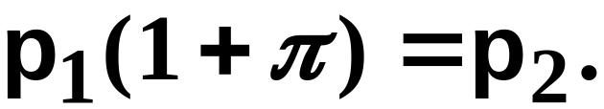
Price Inflation
Define the inflation rate by π where
For example,
π = 0.2 means 20% inflation, and
π = 1.0 means 100% inflation.

Slide 56

Price Inflation
We lose nothing by setting p₁=1 so that p₂ = 1+ π .
Then we can rewrite the budget constraint
as

Slide 57
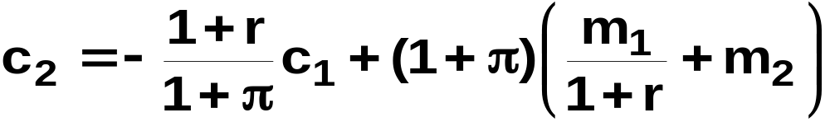
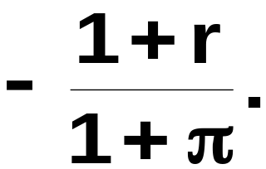
Price Inflation
rearranges to
so the slope of the intertemporal budget
constraint is

Slide 58
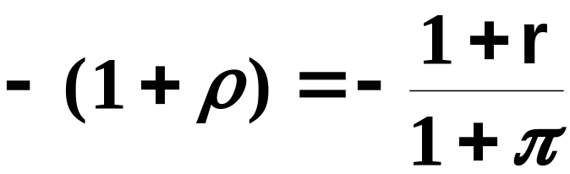
Price Inflation
When there was no price inflation (p₁=p₂=1) the slope of the budget constraint was -(1+r).
Now, with price inflation, the slope of the budget constraint is -(1+r)/(1+ π). This can be written as
ρ is known as the real interest rate （实际利率）.
r is called the nominal interest rate （名义利率）.

Slide 59
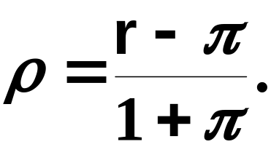
Real Interest Rate
gives
For low inflation rates (π ≈ 0), ρ ≈ r - π .
For higher inflation rates this
approximation becomes poor.

Slide 60

Real Interest Rate

Slide 61
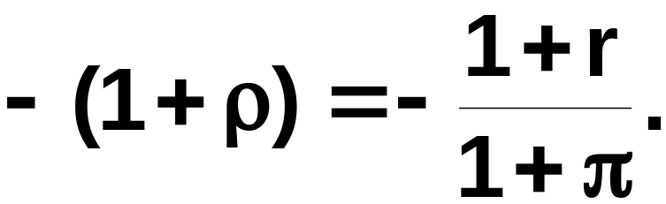
Comparative Statics
The slope of the budget constraint is
The constraint becomes flatter if the inflation rate π rises.
The effect is the same as falling (nominal) interest rate. Both have the effect of decreasing the real rate of interest.
Normal Slutsky equation applies. Note the change of the inflation rate does not have an extra income effect.

